Slide 1
DATA ACQUISITION & DATA WRANGLING NAME: S. SUJANA KUMARI AFFILIATION: DIGICROME ACADEMY

Slide 2
PROJECT OVERVIEW
We are junior data scientists assigned a new task to perform data wrangling on a set of datasets. The datasets have many ambiguities. We must identify those and apply different data-wrangling techniques to get a dataset for further usage.
The following concepts are to be used with the help of a business use case:
Data acquisition.
Data Wrangling:
1. Merging datasets
2. Identifying unique values
3. Dropping unnecessary columns
4. Checking the dimensions of the dataset
5. Checking the datatype of the dataset
6. Checking datatype summary
7. Treating missing values
8. Validating the correctness of the data at the primary level if applicable

Slide 3
METHODOLOGY
LOADING THE DATASETS (i.e., Dataset_1, Dataset_2 and Dataset_3)
LOADING THE LIBRARIES: Include pandas, numpy, sns, matplotlib, scipy etc.
TECHNICAL SKILLS INVOLVED: Data Acquisition and Data Wrangling of the dataset_1, dataset_2 and dataset_3. Merging of the dataset_1 and dataset_2 and working on central tendency. Concatenating the merged dataset 1 and 2 with dataset_3
Codes are executed and run in Jupyter Notebook.
PLATFORM:

Slide 4
KEY FEATURES
DATA ACQUISITION: Identify and obtain access to the data within your sources.
DATA WRANGLING: Data wrangling deals with the below functionalities:
Data exploration: The data is studied, analyzed and understood by visualizing representations of data.
Dealing with missing values: Most of the datasets having a vast amount of data contain missing values of NaN, they are needed to be taken care of by replacing them with the mean, mode, or simply dropping the rowing a NaN value.
Reshaping data: In this process, data is manipulated according to the requirements, where new data can be added or pre-existing data can be modified.
Filtering data: Sometimes datasets are comprised of unwanted rows and columns which are required to be removed or filtered.
Other: After dealing with the raw dataset with the above functionalities we get an efficient dataset as per our requirements and then it can used for a required purpose like data analysing, machine learning, data visualisation, model training, etc.

Slide 5
CODE EXPLANATION
The code is started by importing the important libraries like pandas, numpy, matplotlib, seaborn, etc.
Pandas is most commonly used for data wrangling and data manipulation purposes. Numpy is primarily used to create arrays or matrices that can be applied in Machine Learning models. Matplotlib is a graph plotting library in python that serves as a visualization utility. Seaborn is a library for making statistical graphics in Python.
Loading/reading the first dataset that is dataset_1 from the local data source. Data wrangling of dataset_1 is done like checking the dimensions of the dataset, identifying unique values, checking for missing values and treating them, checking the datatype summary etc.
Loading/reading the second dataset that is dataset_2 and doing the data wrangling of dataset_2 like checking the dimensions of the dataset, identifying unique values, checking for missing values and treating them, checking the datatype summary etc.
Merging of dataset_1 and dataset_2 and naming it as ‘df1’ and doing some data wrangling of the merged dataset as well and saving the merged file in the excel form in our local folder.

Slide 6
CODE EXPLANATION
Loading/reading the third dataset that is dataset_3 and doing the data wrangling of dataset_3 like checking the dimensions of the dataset, identifying unique values, checking for missing values and treating them, checking the datatype summary etc.
Concatenating merged dataset_1 and dataset_2 (i.e., df1) with dataset_3 which is named as ‘df2’ and doing some data wrangling of the merged dataset as well and saving the concatenated file in the excel form in our local folder.
After concatenating the 3 datasets the date column named ‘dteday’ was not in proper format, so converted the date datatype to datetime64[ns].
By checking the unique values of the columns, it was found out that the columns ‘season’ and ‘yr’ had single unique value. So, these 2 columns were dropped as it will not hinder out prediction or analysis.
Detecting and removing the outliers by trying out different methods for some columns of the concatenated dataset df2 like:
Z-Score method for ‘temp’ column of the dataset df2.
IQ that is interquartile range method for ‘atemp’ column of the dataset df2.
Boxplot method for the ‘windspeed’ column of the dataset df2.

Slide 7
CODE EXPLANATION
After trying out all the three methods (Z-score, IQ, Boxplots) to check how the different methods can be used to detect and remove the outliers in a column.
Now the actual Data Cleaning starts by first checking in which columns of the dataset the outliers are present by plotting the boxplots for each and every column.
After detecting the in which columns the outliers are actually present, then comes removing outliers of all the columns at a time by writing a python code and getting a cleaned dataframe free of outliers.
The code involves first defining a function called “outliers” which returns a list of index of outliers, this is done by Interquartile range method by calculating the upper and lower bounds.
Creating an empty list that is the “index_list” to store the output indices from multiple rows by specifying the column names in which the outliers were present which were detected using boxplot.
Checking the shapes of the dataframe before and after removing the outliers and printing the shape by which we can find out how many outliers have been removed.
This dataframe in which the outliers have been removed is named as ‘df2_cleaned.’
Saving of the cleaned dataframe that is ‘df2_cleaned’ to the local folder after checking whether outliers are removed through comparison boxplot.

Slide 8
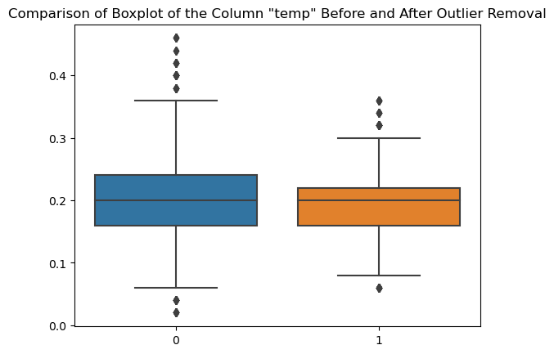
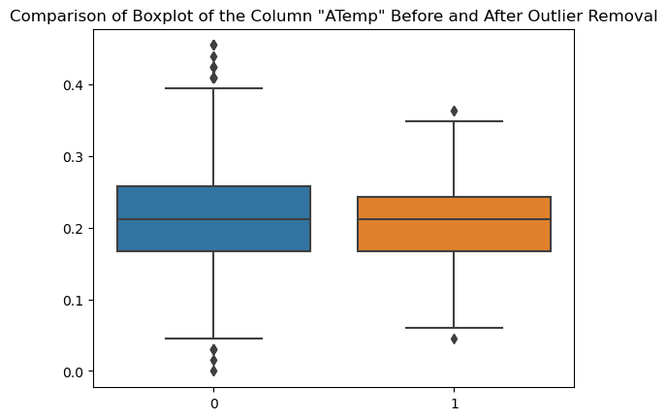
FINAL OUTPUT
Now plotting the comparison box plots for each columns in which the outliers were present to check to what extent the outliers were removed through the Interquartile range method.
Below are the images of the outputs of the comparison Box plots:

Slide 9
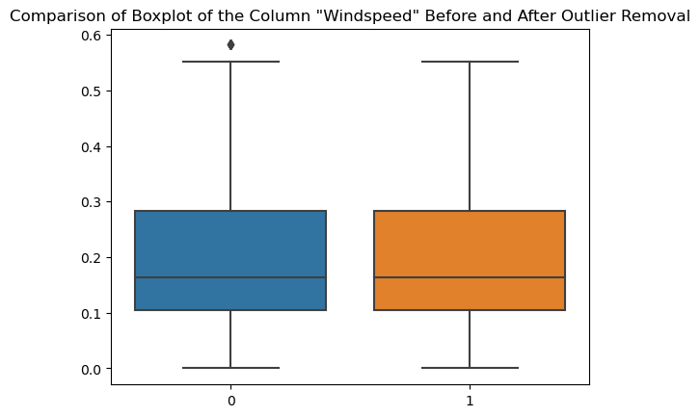
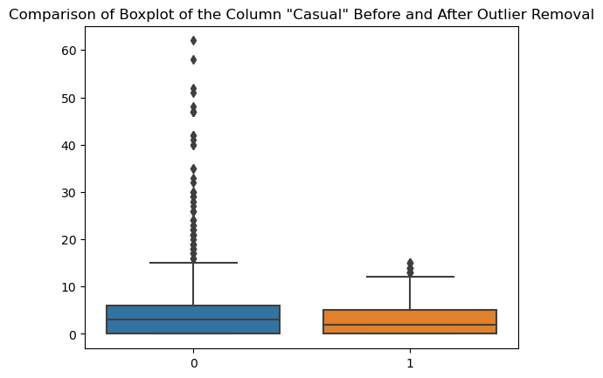
FINAL OUTPUT
Below are the images of the outputs of the comparison Box plots:

Slide 10
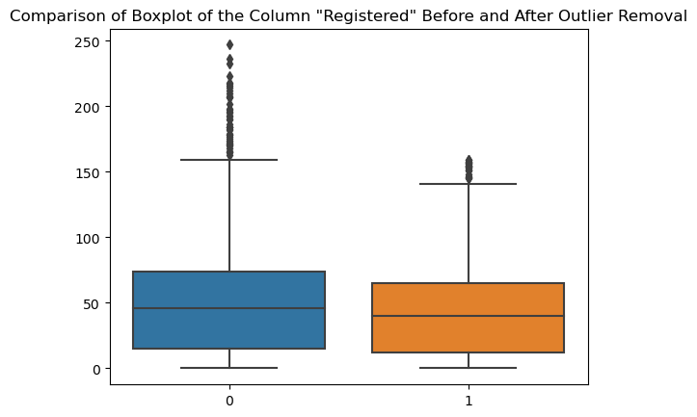
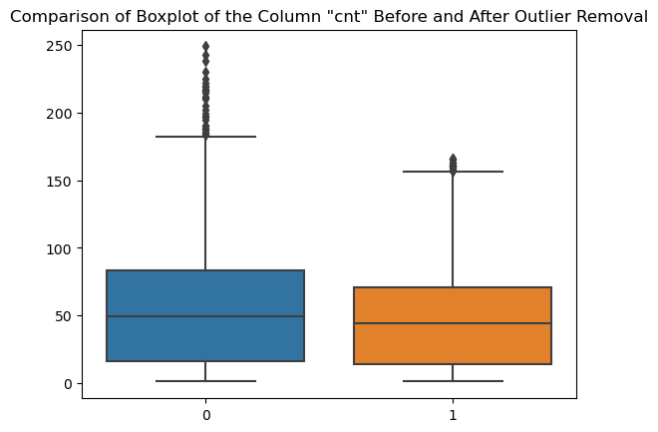
FINAL OUTPUT
Below are the images of the outputs of the comparison Box plots:

Slide 11
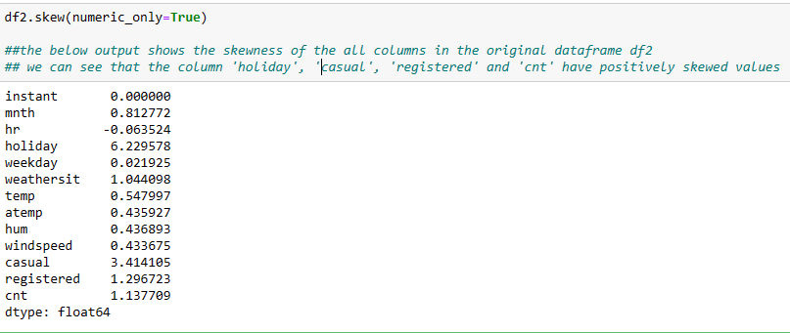
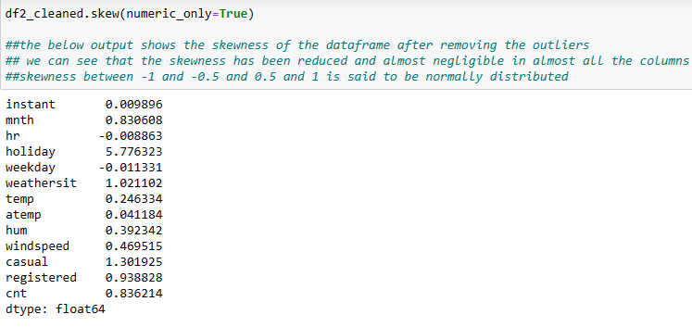
SKEWNESS
After outlier removal checking the skewness of the cleaned dataframe and it shows that almost all the columns are normally distributed and we can also see the comparatively the skewness is reduced after removing the outliers. Below are the screenshots of skewness calculated before and after removal of outliers.

Slide 12
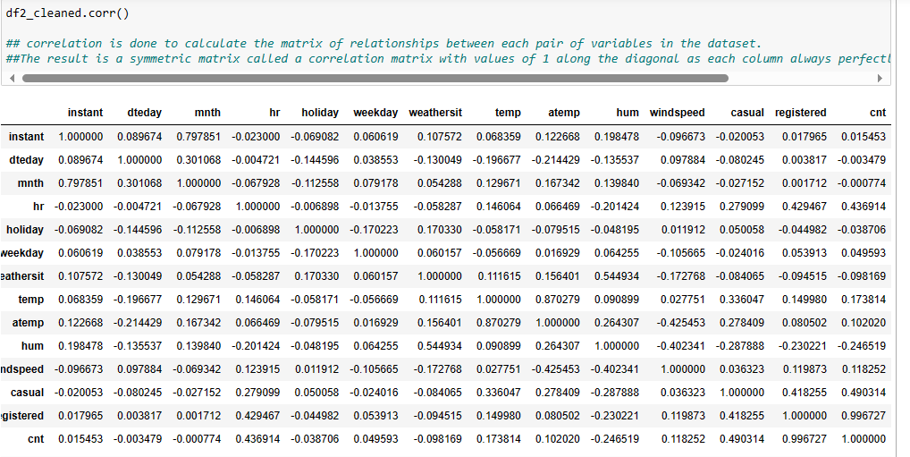
CORRELATION
This is done to calculate a matrix of the relationships between each pair of variables in the dataset. The result is a symmetric matrix called a correlation matrix with the value of 1 along the diagonal as each column always perfectly correlates with itself. Below is the screenshot of the correlation matrix of the cleaned dataset df2_cleaned.

Slide 13
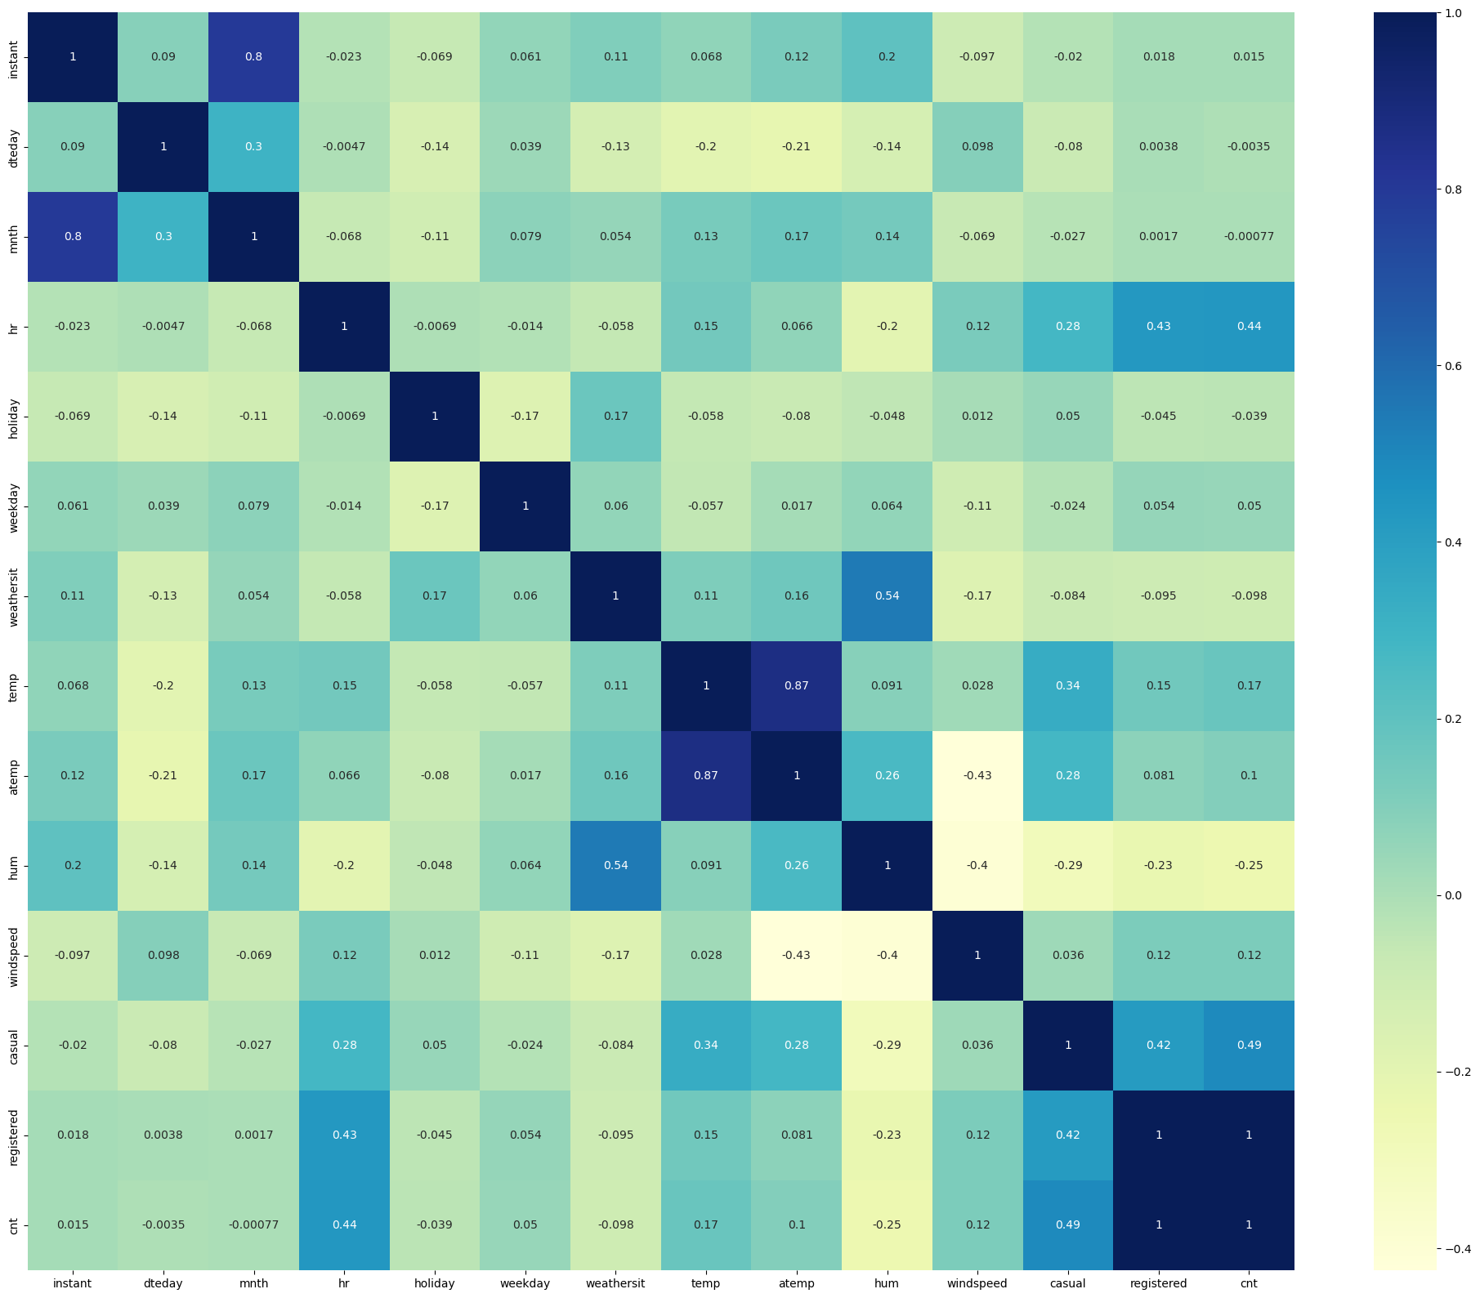
CORRELATION HEATMAP
A correlation heatmap is a graphical tool that displays the correlation between the variables as a color-coded matrix. It’s like a color chart that shows us how closely related different variables are. Below is the image of the correlation heatmap of the cleaned dataset df2_cleaned.

Slide 14
NAME: S. Sujana Kumari
THANK YOU

